Slide 1
Object Retrieving from Image Database
Computer Vision Lab
M1 Nguyen Thien Bao
January 8th, 2010

Slide 2
Contents
Introduction
Motivation
Object detection approach
Experimental result and evaluation
Future work

Slide 3
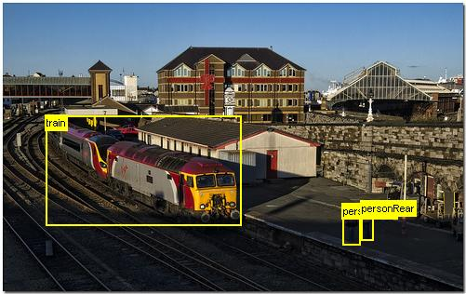
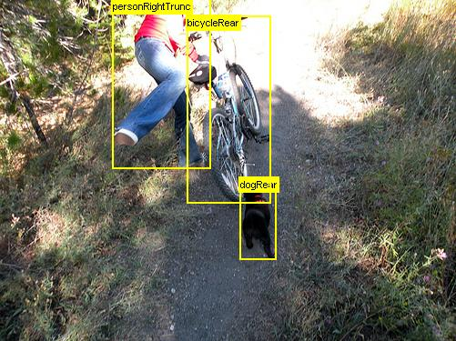
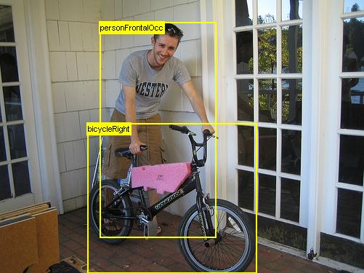
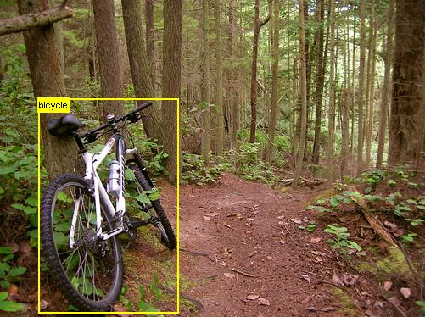
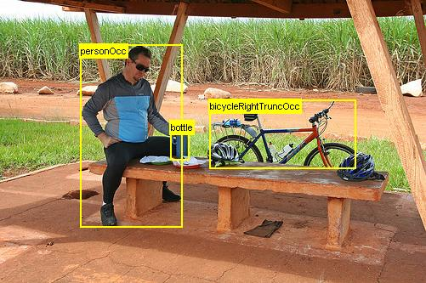
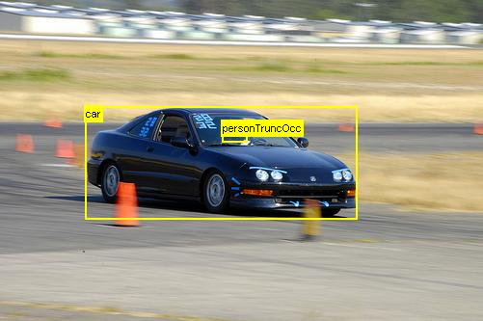
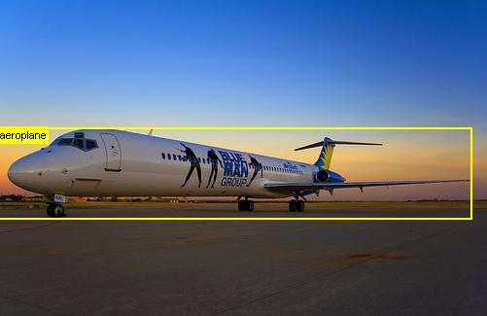
Object Detection v.s. Image Retrieval
Detection
Retrieval
Finding an object of a pre-defined class in a static image/video
Browsing, searching or retrieving images based on the semantic of image.
Fig. 1. Images contain bicycle.

Slide 4
Motivation
Issue:
The more objects a system can detect, the more precise the system is
Semantic of an image is not easy to get
Objectives:
Combine multiple features to detect as many objects as possible

Slide 5
Object detection approach
Input image
Pre-processing
standard image
For each sub-image at each scale
Corner map
Satisfy
Corner map
Satisfy
Orientation
Check on other strong feature
Set of training car images
(1)
Edge map
Satisfy
Edge map
Object
(2)

Slide 6
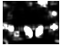
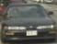

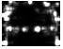
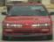




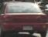

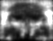
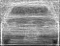

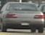

Edge map and corner map (training)
Corner map
Edge map
Fig. 2. Making Edge map & Corner map from training set

Slide 7
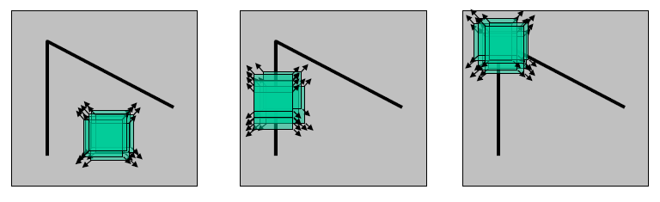
Edge and corner detecting
Shift a window in any direction, see change in intensity to recognize edge or corner
“flat” region
no change in
all directions
“edge”
no change along
the edge direction
“corner”
significant change
in all directions
C.Harris, M.Stephens. “A Combined Corner and Edge Detector”, 1988

Slide 8
Object detection approach
Input image
Pre-processing
standard image
For each sub-image at each scale
Corner map
Satisfy
Corner map
Satisfy
Orientation
Check on other strong feature
Set of training car images
(1)
Edge map
Satisfy
Edge map
Object
(2)

Slide 9
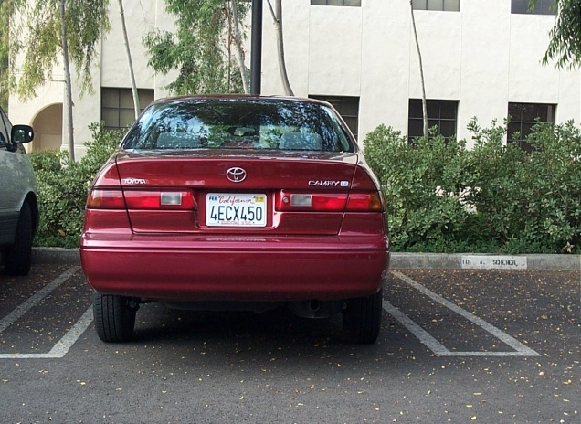

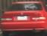
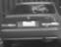
Satisfy edge/corner map (detecting)
edge
sub-image
input image
Edge Map
Satisfy or not
sub image
gray scale sub image
Satisfy condition
n₁/n₂ > C₁
n₂ > θ₁ and n₂ < θ₂
corner
sub-image
Corner Map

Slide 10
Object detection approach
Input image
Pre-processing
standard image
For each sub-image at each scale
Edge map
Satisfy
Corner map
Satisfy
Orientation
Check on other strong feature
Set of training car images
(1)
Corner map
Satisfy
Edge map
Object
(2)

Slide 11
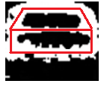

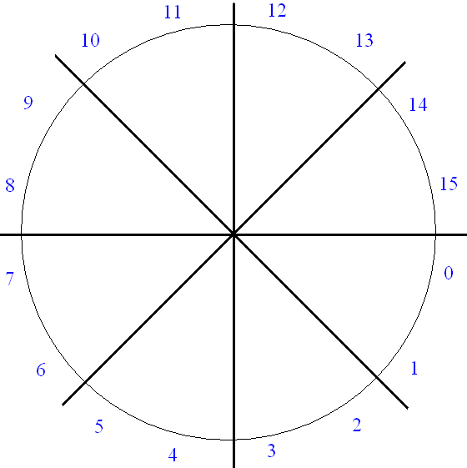
Satisfy edge orientation
With each sub-region
Calculate HoG (histogram of gradient)
The dominant orientation in each sub-region must be horizontal, vertical, or diagonal orientation.
Fig. 3. Orientation region
Condition of horizontal orientation

Slide 12


Result #1: car detection
Separate two types of car:
front/rear view car and side view car
Edge map
Corner map
Edge map
Corner map
Fig. 4. Front/rear view car
Fig. 5. Side view car

Slide 13
Front/rear view car
Training set: 253 images (62x48)
Test set:
Caltech car image database: 504 (128x128 .ppm)
Rear caltech-09: 526 (360x240 .jpg)
Non-car: Set 1: 165 and Set 2: 380 (free-size)
Test | No. image | Correct | Incorrect | False rate | Accuracy rate
Caltech | 504 | 481 | 23 | 4.57% | 95.43%
Rear Caltech-09 | 516 | 475 | 41 | 8.95% | 92.05%
Non- car 1 | 165 | 155 | 10 | 6.06% | 93.94%
Non – car 2 | 380 | 350 | 30 | 7.89% | 92.11%

Slide 14
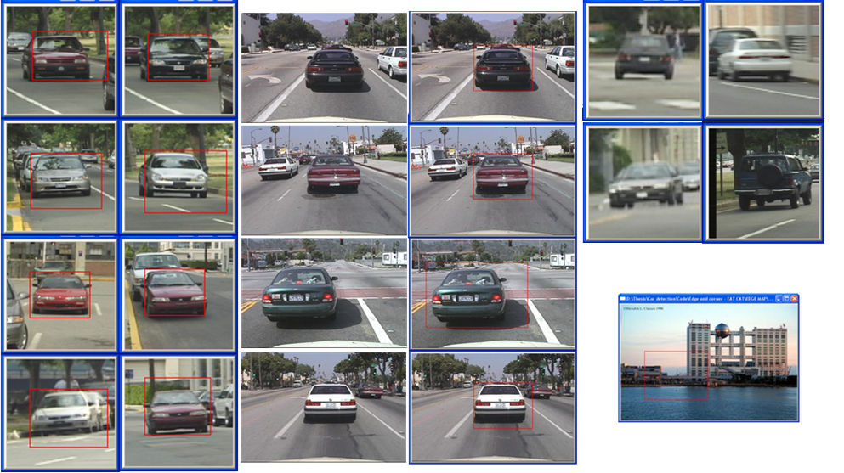
Front/rear view car
True negative
False positive
Fig. 6. Example of front/rear view car detection

Slide 15
Side view car
UIUC car image database
Training set: 250 (100x40)
Test set:
Car: 300 (100x40 .png) + 278 (.png)
Non-car: 500 (100x40 .png) and 380 (free size)
Test | No. image | Correct | Incorrect | False rate | Accuracy rate
UIUC1 | 300 | 275 | 25 | 8.33% | 91.67%
UIUC Test | 278 | 264 | 14 | 5.04% | 94.96%
Non- car 1 | 500 | 480 | 20 | 4.00% | 96.00%
Non – car 2 | 380 | 362 | 18 | 4.74% | 95.26%

Slide 16
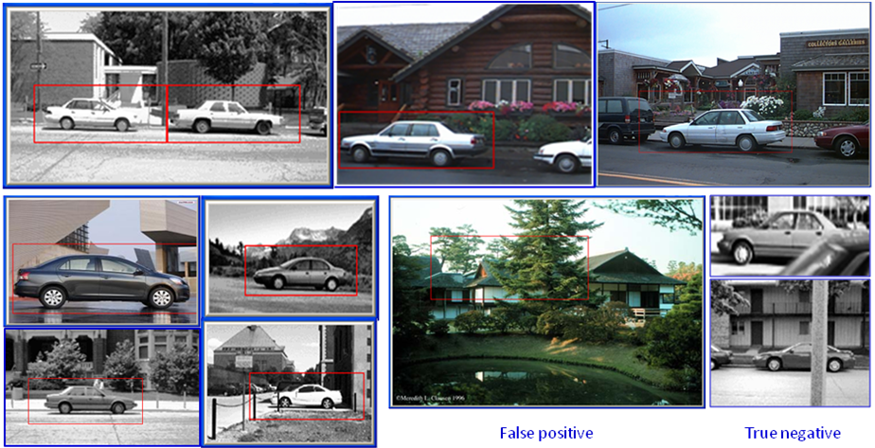
Side view car
False positive
True negative
Fig. 7. Example of side view car detection result

Slide 17
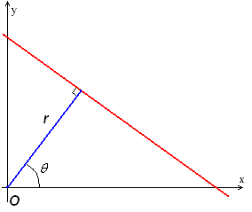
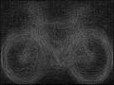
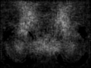
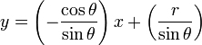
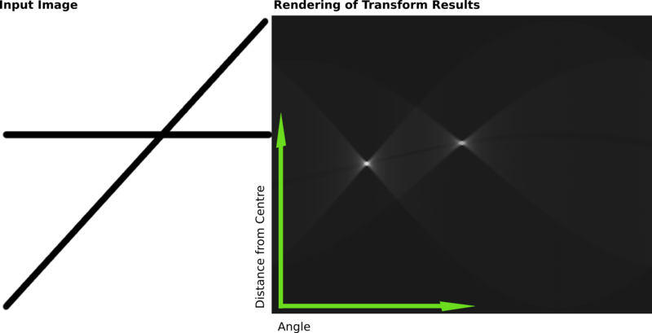
Result #2: Bicycle detection
Edge map
Corner map
Line
Circle
Fig. 8. Strong features of bicycle
Fig. 9. Detect Line and Circle based on Hough Transform

Slide 18
Bicycle detection
Training set: 242 images (120x90)
Test set:
Caltech bike: 365 (free size)
PASCAL VOC: 387 (free size .jpg)
Non-bike: Set 1: 171 (.jpg) + Set 2: 380 (free size)
Test | No. image | Correct | Incorrect | False rate | Accuracy rate
Caltech bike | 365 | 261 | 104 | 28.49% | 71.51%
PASCAL VOC | 387 | 295 | 92 | 23.77% | 76.23%
Non- bike 1 | 171 | 140 | 31 | 18.13% | 81.87%
Non- bike 2 | 380 | 356 | 24 | 6.32% | 93.68%

Slide 19
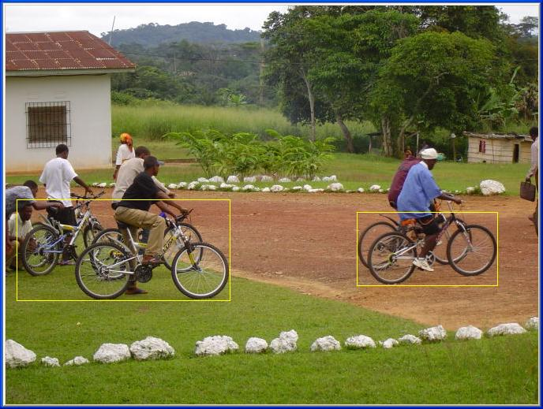
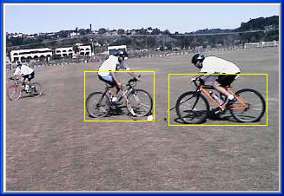
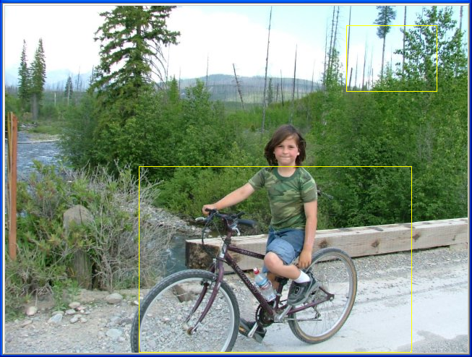
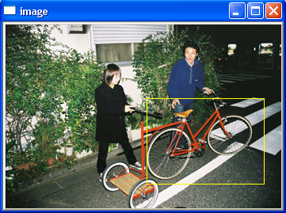
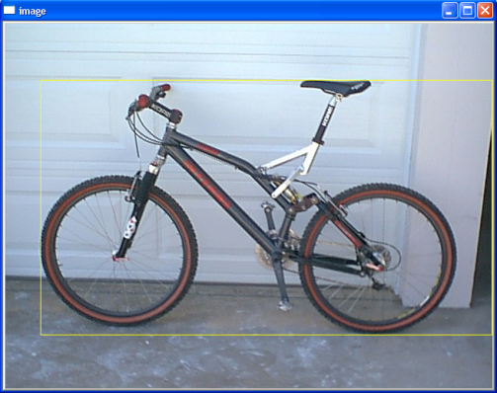
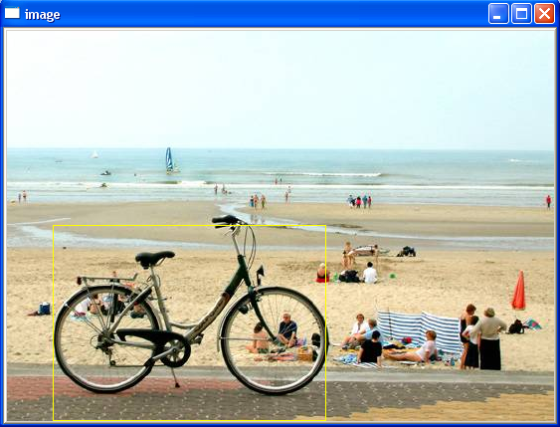
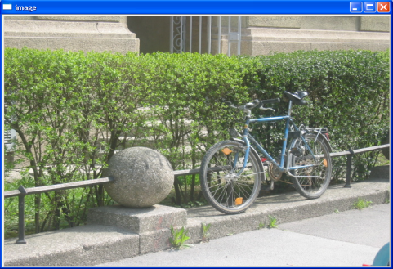
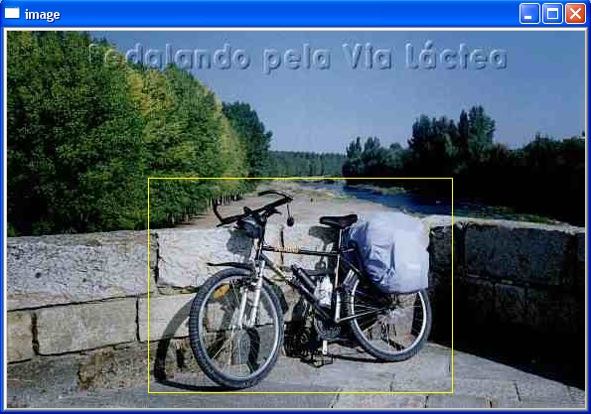
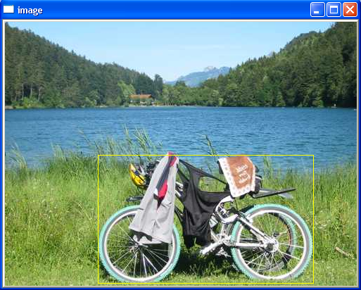
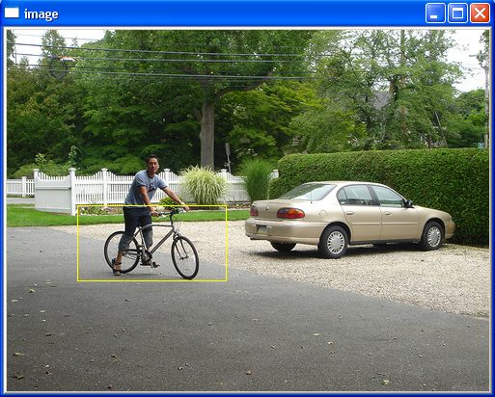
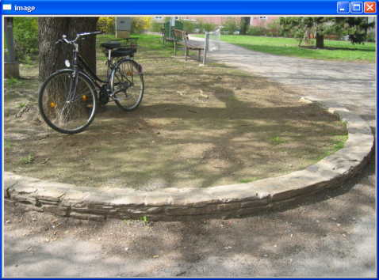
Bicycle detection
False positive
True negative
Fig. 10. Example of bicycle detection result

Slide 20

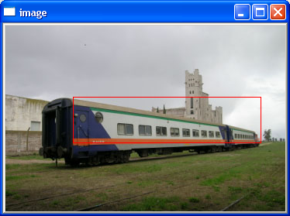

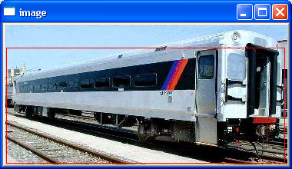
Result #3: Train detection
Corner map
Edge map
The angle between two strongest lines satisfies
θ₁ < θ < θ₂
Two strongest lines
Fig. 11. Features of train

Slide 21
Rail train detection
Training set: 228 images (90x40)
Test set:
PASCAL VOC: 378 (free-size)
Web: 395 ( .jpeg, free-size)
Non-train: Set 1: 165 + Set 2: 380 (free-size)
Test | No. image | Correct | Incorrect | False rate | Accuracy rate
PASCAL VOC | 378 | 300 | 78 | 20.63% | 79.37%
Web | 395 | 306 | 89 | 22.53% | 77.47%
Non- train 1 | 165 | 135 | 30 | 18.18% | 81.82%
Non- train 2 | 380 | 345 | 35 | 9.21% | 90.79%

Slide 22
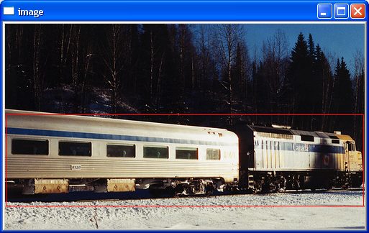
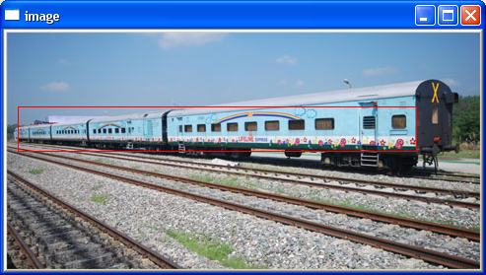
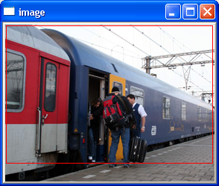
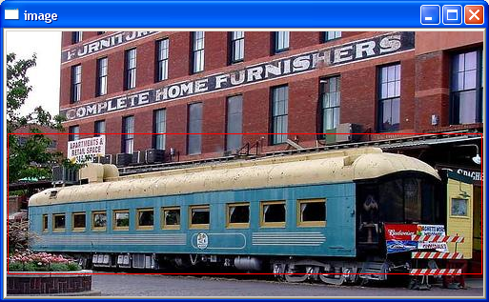
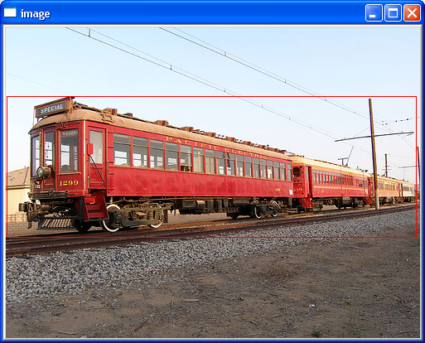
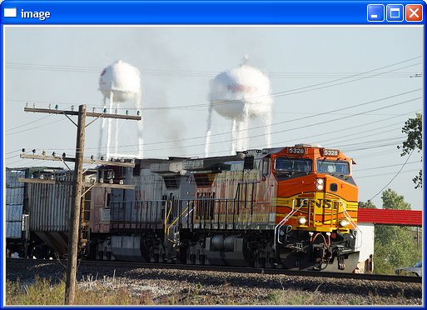
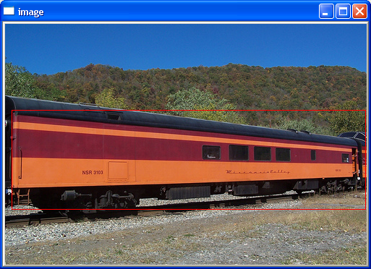
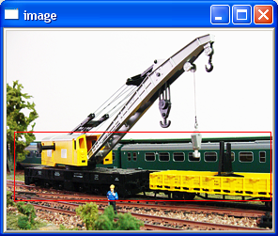
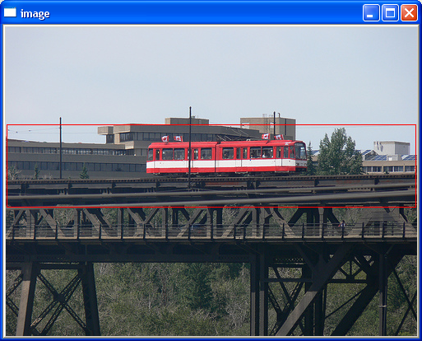
Fig. 12. Example of rail-train detection result
True negative & False positive

Slide 23
Airplane detection
Input image
Pre-processing
standard image
For each sub-image at each scale
Edge map
Satisfy
Corner map
Set of training car images
Satisfy
Orientation
Check on SURF feature
Corner map
Satisfy
Edge map
Object

Slide 24




SURF (Speed-Up Robust Feature)¹
Alternative to SIFT², but faster about three or more times.
Invariant: rotation, scale, illumination and small change in viewpoint.
SURF descriptor
x, y
scale
dominant orientation
4x4x4=64 dimension
¹ Bay et al, “Speeded up robust features”, ECCV, 2006
² Lowe, “Distinctive image features from scale-invariant keypoints”, IJCV, 2004

Slide 25



Result #4: Aero plane detection
Corner map
Edge map
SURF feature
SURF points
SURF descriptors
Quantize to k bins
Naïve Bayes
Calculate
I: input image; Cj: class (plane or non-plane)
v_{t} : vocabulary (bin[t]); N^{(t,I)}: histogram of v_{t} in I
Choose the class : argmax{P(C _{j} | I)}
Plane
Non-plane

Slide 26
Aero plane detection
Training set: 420 images (150x50)
Test set:
Caltech aero plane: 677 (.png)
Caltech 09: 987 (.jpg)
Non-plane: Set 1: 245 + Set 2: 380 (free-size)
Test | No. image | Correct | Incorrect | False rate | Accuracy rate
Caltech | 677 | 594 | 83 | 12.26% | 87.74%
Caltech 09 | 987 | 803 | 184 | 18.64% | 81.36%
Non- plane 1 | 245 | 208 | 37 | 15.17% | 84.83%
Non- plane 2 | 380 | 340 | 40 | 10.53% | 89.47%

Slide 27



Aero plane detection
Fig. 14. Example of aero plane detection result

Slide 28
Conclusion and Evaluation
Combine Edge, Corner, HoG and SURF feature for detecting four categories: car, bike, train and plane.
If the object has unchanged-size, the result is better.
Combination with SURF gets higher accuracy rate.
SURF works well with object having “large surface” (plane, train).

Slide 29
Evaluation
Object | ECH |  | SURF |  | ECH+SURF
 | Average Precision | Average Recall | Average Precision | Average Recall | Average Precision | Average Recall
F/r car | 97.40% | 89.71%
Side car | 95.83% | 92.38%
Bike | 83.76% | 72.64% | 69.04% | 88.71% | 76.80% | 70.69%
Train | 76.28% | 75.75% | 71.92% | 72.10% | 84.05% | 74.10%
Aero plane | 79.77% | 80.95% | 80.41% | 88.17% | 85.59% | 87.56%
Table 1. Comparison between ECH, SURF and combination

Slide 30
Future work
Continue testing on other object such as person, building, animal, furniture, etc.
Apply other feature to find which feature is most suitable for which object.
Automatically choose feature for recognizing new object.

Slide 31
Thank you

Slide 32

SIFT (Lowe)
Find local maximum of Difference of Gaussians
scale
← DoG →
y
← DoG →
x
D.Lowe. “Distinctive Image Features from Scale-Invariant Keypoints”. IJCV 2004

Slide 33

Difference of Gaussians images
Functions for determining scale
Kernels:
(Difference of Gaussians)
where Gaussian

Slide 34


Slide 35
SURF (Bay)
Find local maximum of Laplacian of Gaussians
Bay et al, “Speeded up robust features”, ECCV, 2006

Slide 36
Laplacian images
Functions for determining scale
Kernel:
(Laplacian)
where Gaussian

Slide 37
Evaluation
Object | Our system | PASCAL VOC 2009
 | Average Precision | Average Precision | Authors
Front/rear car | 97.40% | 37.20% | UoCTTI_LSVM-MDPM
Side car | 95.83%
Bicycle | 83.76% | 46.80% | UoCTTI_LSVM-MDPM
Train | 84.04% | 46.30% | OXFORD_MKL
Plane | 85.59% | 47.80% | OXFORD_MKL
Table 1. Comparison between our system with PASCAL 09

